Slide 1
COVID-19 Dashboard
The Power BI file contains the data model and interactive graphics in a Power BI template.
Covid-19 dashboard enables customize an interactive report about COVID-19
Power BI enables to visualize and analyze your data in a way that makes it easier to identify trends, patterns.

Slide 2
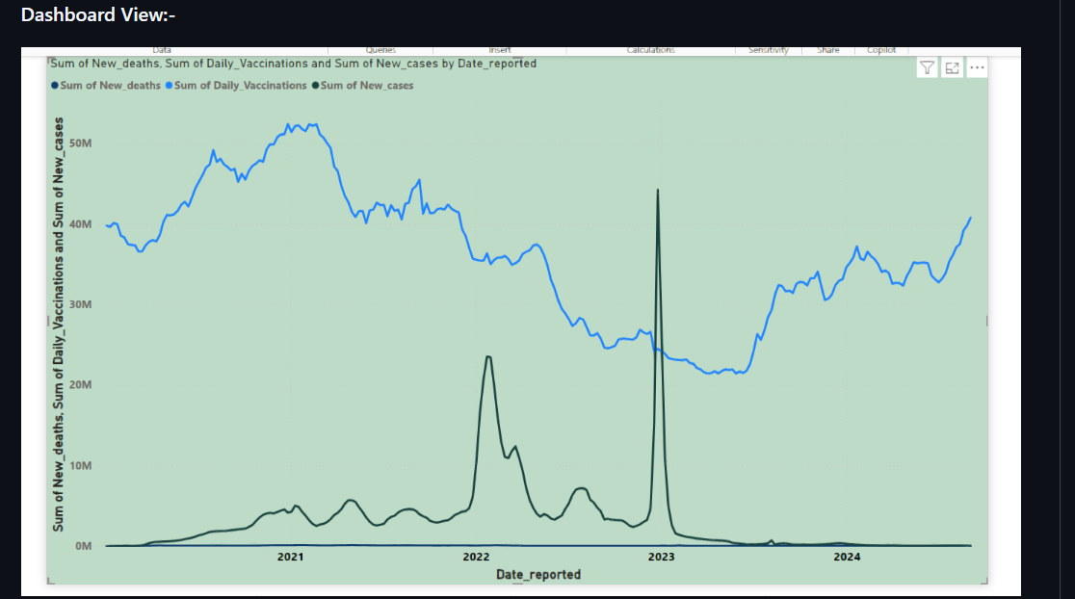

Slide 3
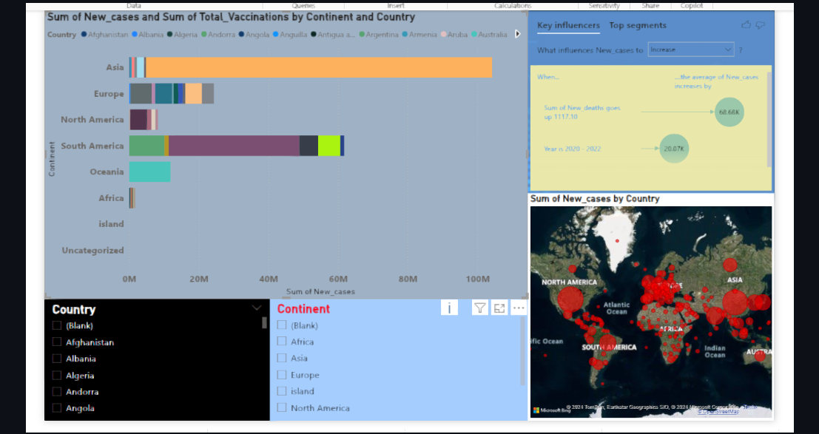

Slide 4
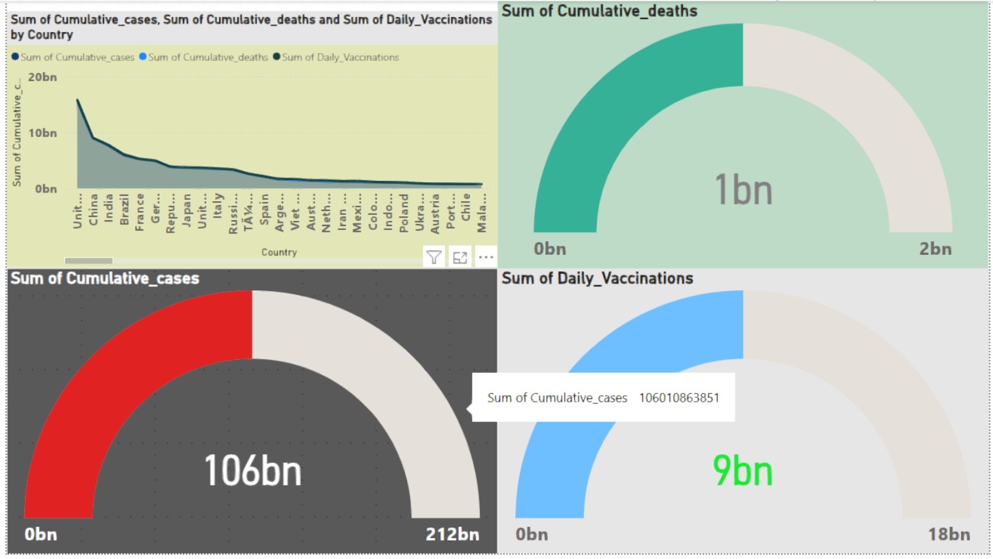

Slide 5
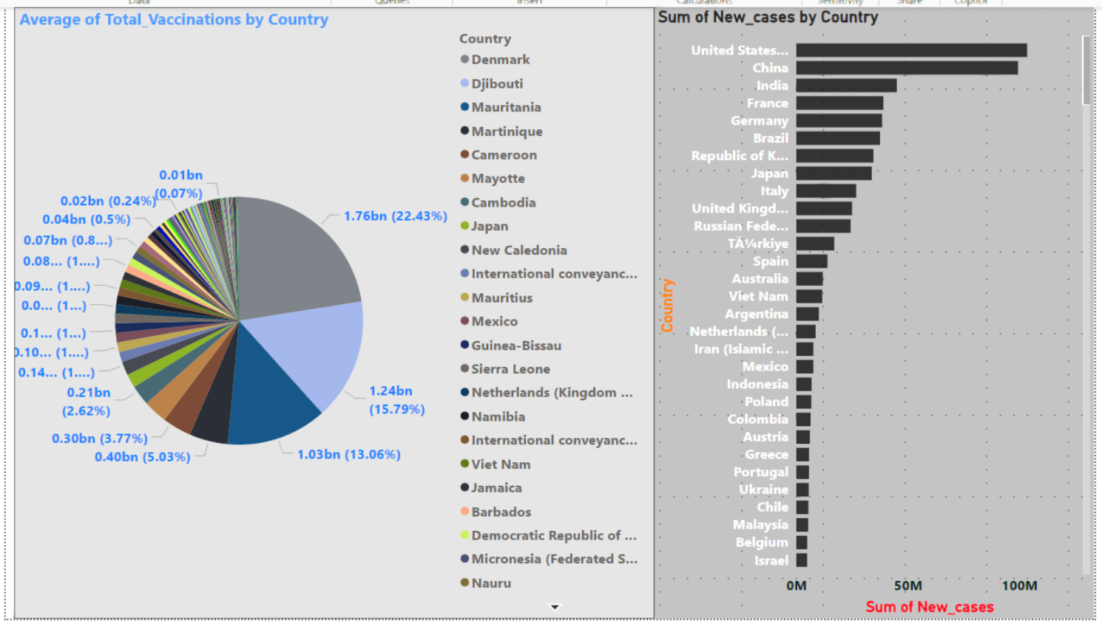

Slide 6
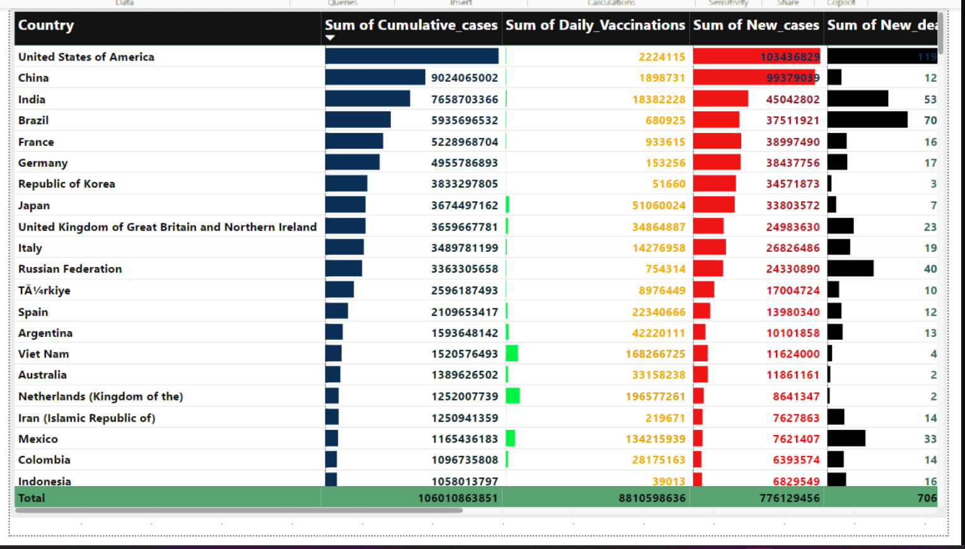

Slide 7
Questions:-
How do daily new COVID-19 cases, deaths, and vaccinations fluctuate over time? Can we identify any significant peaks or drops in the data?
Is there a clear correlation between an increase in daily vaccinations and a decrease in daily new cases in specific regions?
What factors seem to influence the number of COVID-19 cases most significantly in different regions?
How does the COVID-19 situation (cases, deaths, vaccinations) differ when focusing on specific countries or regions using the slicer?
Which countries or regions are most affected by the pandemic according to the intensity of new cases shown on the map?
How have cumulative cases grown across various countries over time? Are there any countries where the cumulative cases are rising more rapidly?
What is the current global status of cumulative COVID-19 cases, deaths, and daily vaccinations, and how do these numbers compare across different regions?
What is the distribution of total vaccinations across different countries or regions, and which regions have vaccinated the largest percentage of their population?
Which 10 countries are driving the highest numbers of new COVID-19 cases globally, and how does the case count compare between them?
What do the average cumulative cases, new cases, deaths, and vaccinations reveal about the overall severity of the pandemic in various countries?

Slide 8
Insights from dashboard:-
Line Chart:
The line chart shows that daily new COVID-19 cases, deaths, and vaccinations follow certain trends over time. There are periods of spikes in cases and deaths corresponding with surges of the virus, while vaccinations often increase steadily. A noticeable trend can be observed when the daily vaccinations start to rise, cases and deaths gradually decline in some regions, particularly after mass vaccination campaigns.
Stacked Bar Chart:
The stacked bar chart shows that in some regions, like the U.S. and parts of Europe, an increase in daily vaccinations correlates with a reduction in daily new COVID-19 cases. However, in regions with slower vaccine rollouts, such as some parts of Africa, the decline in cases is less apparent, and the effect of vaccinations seems to lag behind.
Key Influencer Chart:
The key influencers behind COVID-19 case increases seem to include population density, vaccination rates, and government restrictions. In regions with low vaccination rates and high population density, such as India during the second wave, cases rise rapidly. Conversely, regions with early lockdowns and high vaccination rates saw fewer case spikes.
Slicer:
When analyzing specific countries or regions using the slicer, we observe that developed countries, such as the U.S. and U.K., have higher vaccination rates and lower subsequent new cases. In contrast, developing countries with less access to vaccines, like parts of Africa and Asia, continue to struggle with higher numbers of new cases and lower vaccination rates.

Slide 9
Map Chart:
The map shows that the U.S., India, and Brazil are among the countries most severely impacted by COVID-19, with the intensity of new cases remaining high throughout much of the pandemic. These regions consistently show darker areas on the map, indicating more significant outbreaks.
Stacked Area Chart:
Cumulative cases have grown rapidly in countries like the U.S., India, and Brazil. In countries with strong pandemic responses and vaccination efforts, such as New Zealand and parts of Europe, the cumulative growth rate slowed significantly after vaccines were introduced.
Gauge Chart:
The global status of COVID-19 shows a total of billions of cumulative cases, deaths, and vaccinations. North America and Europe show higher total vaccination numbers compared to Africa and parts of Asia. The pandemic has resulted in a significant global death toll, although regions with early vaccination rollouts and strict lockdown measures have relatively fewer deaths.
Pie Chart:
The pie chart reveals that a large proportion of the world's vaccinations are concentrated in a few regions. The U.S., Europe, and China have administered the most vaccines, while regions such as Africa remain underrepresented in the total vaccination percentage. The distribution highlights inequities in vaccine access globally.
Clustered Bar Chart:
The top 10 countries driving the highest new COVID-19 cases include the U.S., India, and Brazil. These countries account for a significant portion of the global case count, with the U.S. consistently leading in new cases during most time periods, followed closely by India and Brazil.
Table Chart:
The table chart reveals that countries with high cumulative cases, such as the U.S., Brazil, and India, have also seen a substantial number of deaths and vaccinations. The average sum of new cases and deaths indicates that the pandemic remains severe in regions with large populations and slower vaccine rollouts.

